Slide 1

Chapter -3
Windows Operating
System

Slide 2
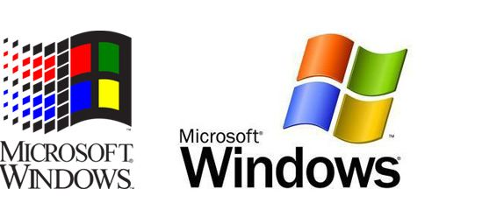
What is meant by
Windows Operating System?
A group of several graphical operating system families, all of which are developed, marketed, and sold by Microsoft.
As a graphical operating system shell for MS-DOS in response to the growing interest in graphical user interfaces
(GUIs).

Slide 3
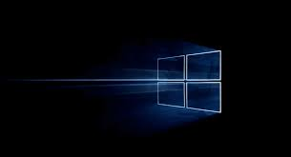
As of December 2017, the most recent version of Windows for PCs, tablets, smartphones and embedded devices is
Windows 10.
The most recent versions for server computers is Windows Server 2016.

Slide 4
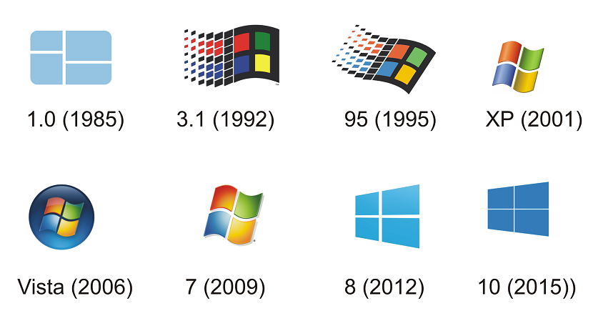
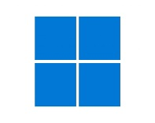
History
&
Development
11(2021)

Slide 5
Earlier, there were no operating systems
Each user used the machine for a scheduled
period of time
Often on punched paper cards and magnetic
The program would be loaded into the machine,
and the machine would be set to work until the
program completed or crashed
Then Windows introduced

Slide 6
Windows Timeline
Windows 1.0-2.0
Windows 95
Windows 2000
1995
2000
1985-1992
1990-1994
1998
2001
Windows 3.0-3.1
Windows 98
Windows XP

Slide 7
Windows Timeline(Contd.)
Windows 8
Windows 11
Windows Vista
2012
2021
2006
2009
2015
Windows 7
Windows 10

Slide 8
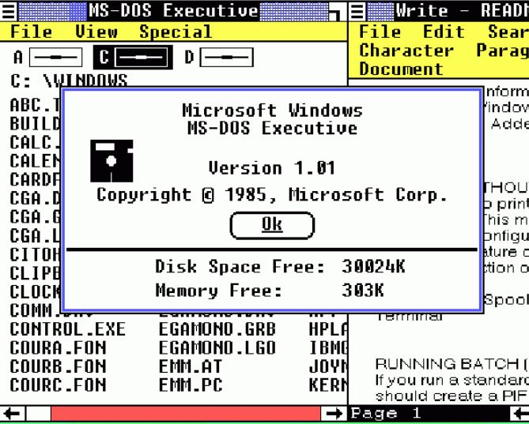
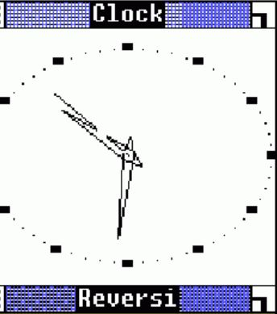
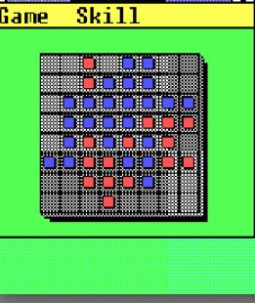
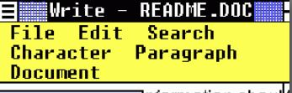
Windows 1.x
Pure operating environment
Used GUI(Graphical user
interface)
Simple graphics

Slide 9
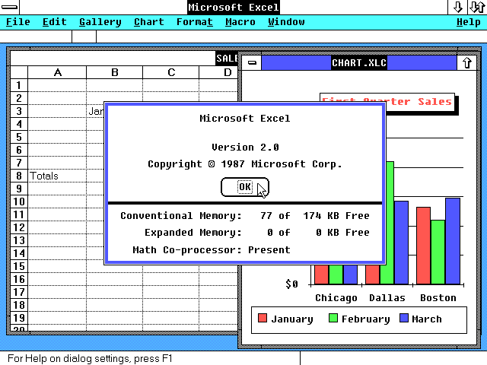
Windows 2.x
16-bit Microsoft Windows GUI-based operating environment
Faster than 1.x
Introduced the control panel
Introduced first version on excel
and word

Slide 10
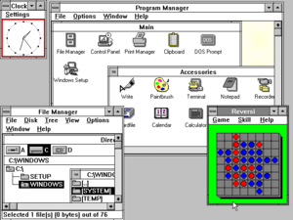
Windows 3.x
Operated with 8086
microprocessor
Virtual memory
Operated with 6-7 MB of free
space of hard drive
Better multitasking

Slide 11
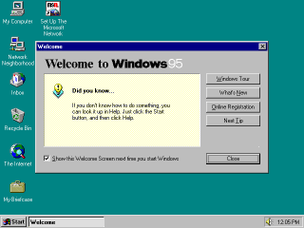
Windows 95
A complete operating system
Improved windows control and appearance
Right button menu
Task bar and start menu

Slide 12
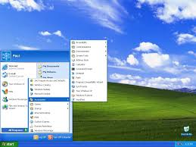
Windows XP
Advanced portable PC support
Automatic wireless connection
support
Fast start-up
Help and support center
Better graphical user interface

Slide 13
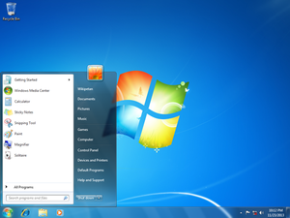
Windows 7
Introduced a large number of new features
Incremental upgrade to the Windows line
Windows 7 has multi-touch support
redesigned Windows shell with an updated taskbar
a home networking system called Home Group, and performance improvements.

Slide 14
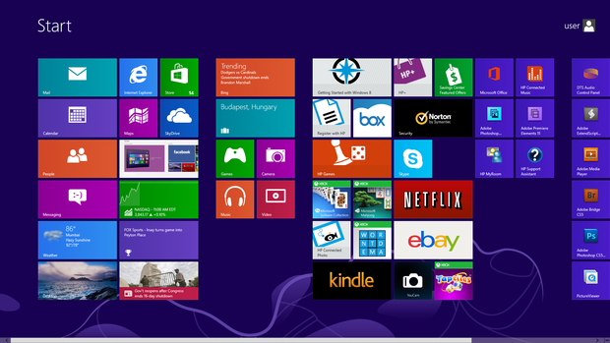
Windows 8
Optimizations for touch-based
Devices such as tablets and all-in-one
pcs
Increased integration with cloud services
Other online platforms (such as social networks and microsoft's own onedrive (formerly skydrive) and xbox live
services)
The Windows Store service for
software distribution

Slide 15
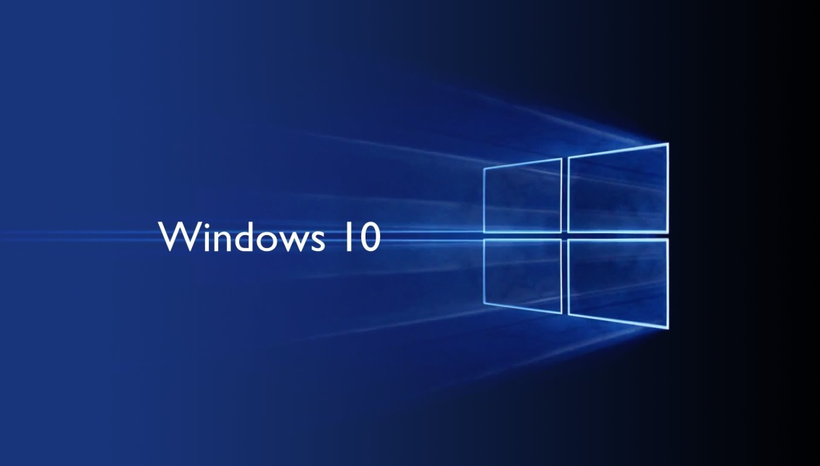
Windows 10
Addresses shortcomings in the user
interface first introduced with
windows 8
The return of the start menu
A virtual desktop system
The ability to run windows store apps within windows on the desktop rather than in full-screen mode
Includes new icons and right-click context menus, default printer management, four times as many tiles allowed in the start menu, find My Device, and Edge updates.

Slide 16
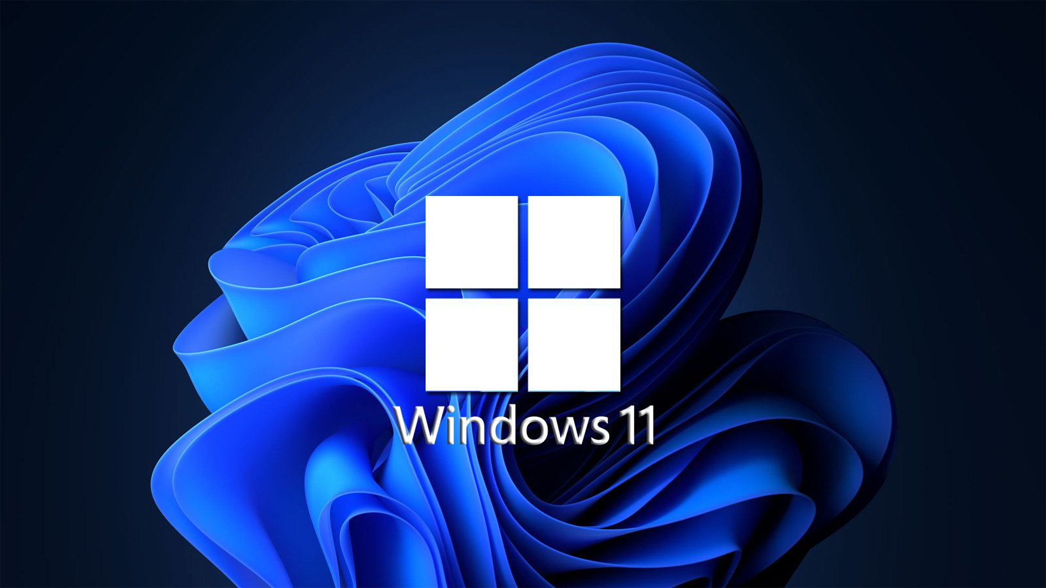
Windows 11
Start Menu Folders
New Touch Gesture
Improved quick Access
Do Not Disturb & Focus Mode
Live Captions
Redesigned Task Manager
Advantages
Beautiful, more consistent new design.
Great window layout options.
Strong video gaming updates.
Performance-improving features.
Better multi-monitor functionality.
Planned support for Android apps.

Slide 17
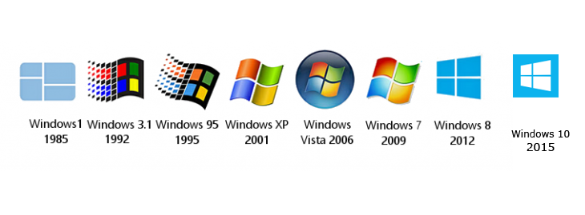
Versions of Windows

Slide 18
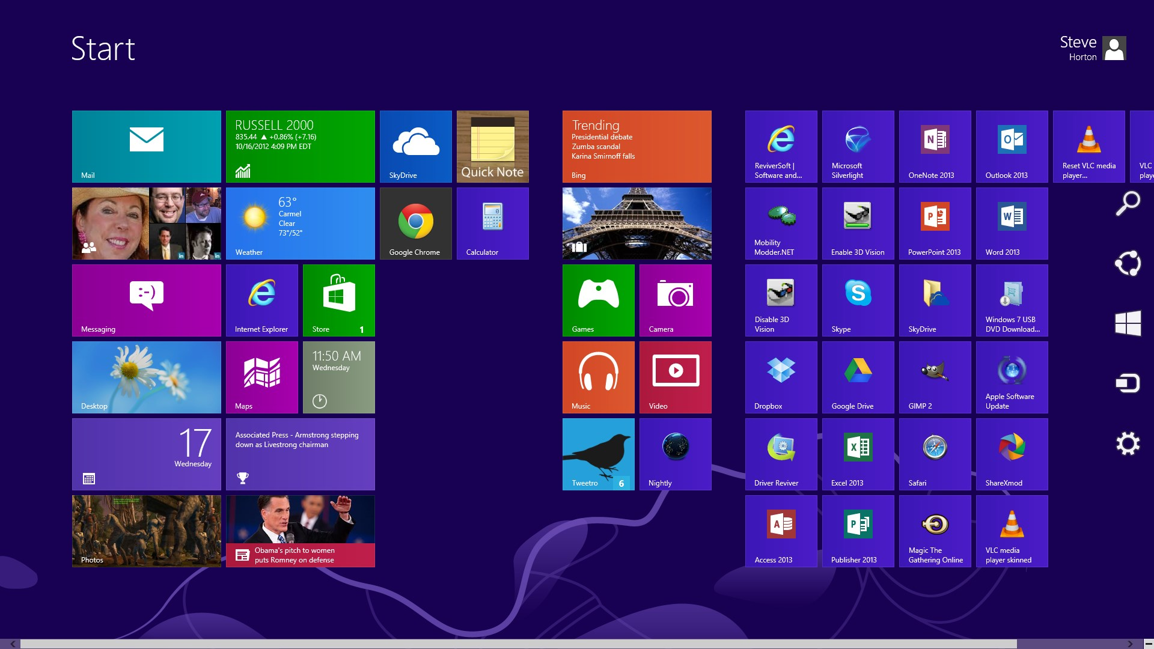
Application in Windows
We can find almost all types of application in windows store. Which we need in our daily life.
Many applications like Adobe Photoshop Enterprise, Adobe Reader, Facebook, Messenger, Media Players etc can be found in Windows Store.

Slide 19
Most Common Features
Program Execution
Providing user interface
Handling input/output operations
Error handling
Memory management
Process management

Slide 20
Functions of an operating system
Process management
Code execution
Context switching
Multitasking
Memory management
Allocation
Sharing
Protection
Virtual memory
Device management
Input / Output
Disk access
Interrupt handling
20

Slide 21
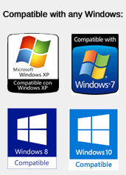
Compatibility
Any one can install any types of software & games into windows.
It is compatible of all types of software & games.

Slide 22
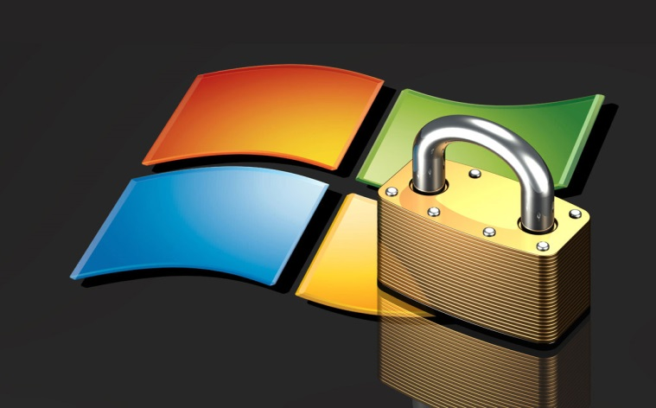

Security
It is less secured than other Operating System due to its popularity.
There are about 60,000 viruses known for Windows.
There are numerous anti virus program in
windows.
22

Slide 23
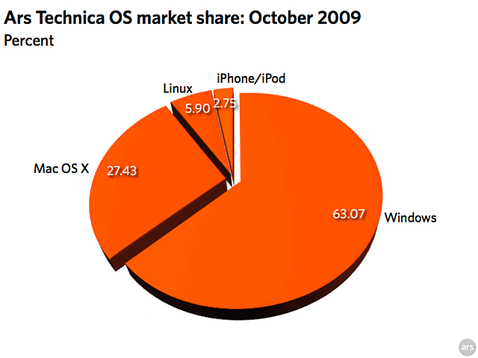
Popularity
Currently Windows is the most popular OS
About 63.07% of total user, uses Windows Operating System.
People like Windows OS because of its Low Price as well as the GUI’s.

Slide 24
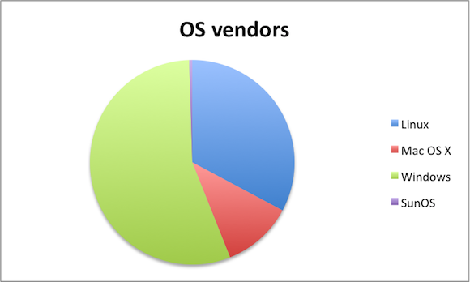
Popularity (Cont.)
Now a days Windows Operating System provides the highest amount of vendors among all the Operating System
Windows OS provides more than 50% of the total Vendors while Mac OS X provides about 20% and Linux provides about 25%.

Slide 25
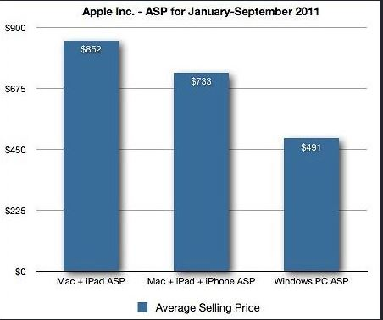
Price?
Windows is less expensive.
It can be found around 40% cheaper than a Mac.
Current prices are available on Amazan.com

Slide 26
Functionality of Operating System
Process Management
The processor is the execution of a program that accomplishes the specified work in that program. It can be defined as an execution unit where a program runs. It is also called CPU Scheduling.
Activities of process management:
All process start to shut down
Booting, Open, save, install, copy, print etc.
Creation & deletion of user & system process
Detailed discussion: https://www.youtube.com/watch?v=OrM7nZcxXZU

Slide 27
Functionality of Operating System
Memory Management
It is the management of the main or primary memory. Whatever program is executed,
it has to be present in the main memory. Main memory is a quick storage area that
may be accessed directly by the CPU. When the program is completed, the memory
region is released and can be used by other programs. Therefore, there can be more
than one program present at a time.
The operating system:
Allocates and deallocates the memory.
Keeps a record of which part of primary memory is used by whom and how much.
Distributes the memory while multiprocessing.
In multiprogramming, the operating system selects which processes acquire memory
when and how much memory they get.
Detailed Discussion: https://www.youtube.com/watch?v=qdkxXygc3rE

Slide 28
Functionality of Operating System
Device Management
An operating system regulates device connection using drivers. The processes
may require devices for their use. This management is done by the OS. It controls Input/Output devices like disk, microphone, keyboard, printer, magnetic tape,
USB ports, camcorder, scanner,
The operating system:
Allocates and deallocates devices to different processes.
Keeps records of the devices.
Decides which process can use which device for how much time.

Slide 29
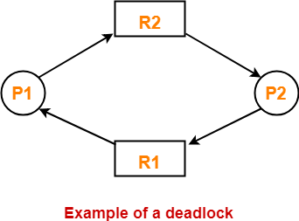
Deadlock
Deadlock is a situation where the execution of two or more processes is blocked because each process holds some resource and waits for another resource held by some other process.

Slide 30
Deadlock
Here,
Process P1 holds resource R1 and waits for resource R2 which is held by process P2.
Process P2 holds resource R2 and waits for resource R1 which is held by process P1.
None of the two processes can complete and release their resource.
Thus, both the processes keep waiting infinitely.
Conditions For Deadlock
There are following 4 necessary conditions for the occurrence of deadlock-
Mutual Exclusion
Hold and Wait
No preemption
Circular wait

Slide 31
Paging
Paging is a storage mechanism used to retrieve processes from the secondary storage into the main memory in the form of pages.
It divides each process in the form of pages. The main memory will also be divided in the form of frames.
One page of the process is to be stored in one of the frames of the memory. The pages can be stored at the different locations of the memory but the priority is always to find the contiguous frames or holes.
Pages of the process are brought into the main memory only when they are required otherwise they reside in the secondary storage.

Slide 32
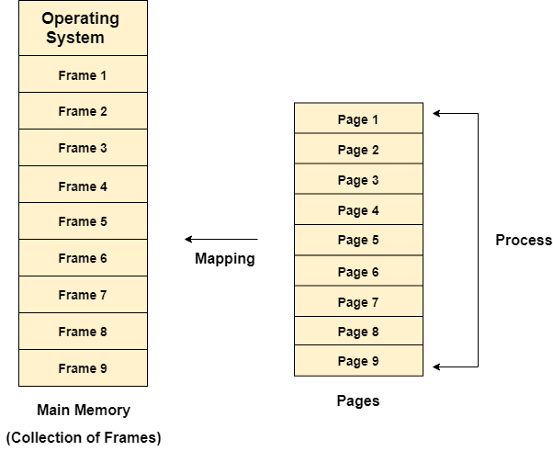
Paging
Different operating system defines different frame sizes. The sizes of each frame must be equal. Considering the fact that the pages are mapped to the frames in Paging, page size needs to be as same as frame size.

Slide 33
Paging
Example
Let us consider the main memory size 16 Kb and Frame size is 1 KB therefore the main memory will be divided into the collection of 16 frames of 1 KB each.
There are 4 processes in the system that is P1, P2, P3 and P4 of 4 KB each. Each process is divided into pages of 1 KB each so that one page can be stored in one frame.
Initially, all the frames are empty therefore pages of the processes will get stored in the contiguous way.

Slide 34
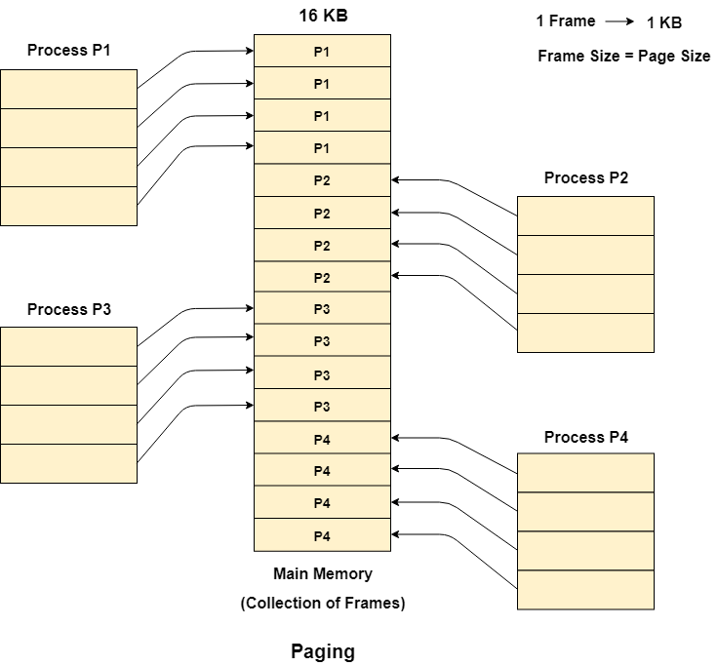
Paging

Slide 35
Threading
A thread is a single sequential flow of execution of tasks of a process so it is also known as thread of execution or thread of control. There is a way of thread execution inside the process of any operating system.
There can be more than one thread inside a process.
Each thread of the same process makes use of a separate program counter and a stack of activation records and control blocks.
Thread is often referred to as a lightweight process.
The process can be split down into so many threads. For example, in a browser, many tabs can be viewed as threads. MS Word uses many threads - formatting text from one thread, processing input from another thread, etc.

Slide 36
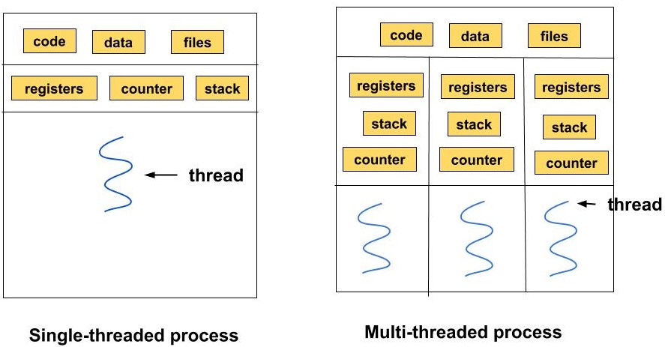
Threading

Slide 37
Threading
Needs of Threading
It takes far less time to create a new thread in an existing process than to create a new process.
Threads can share the common data, they do not need to use Inter- Process communication.
Context switching is faster when working with threads.
It takes less time to terminate a thread than a process.

Slide 38
Threading
Types of Thread
User-Level Thread
Kernel-Level Thread
User-Level Thread
The user-level threads are managed by users and the kernel is not aware of it.
These threads are faster to create and manage.
The kernel manages them as if it was a single-threaded process.
It is implemented using user-level libraries and not by system calls. So, no call to the operating system is made when a thread switches the context.
Each process has its own private thread table to keep the track of the threads.

Slide 39
Threading
Kernel-Level Thread
The kernel knows about the thread and is supported by the OS.
The threads are created and implemented using system calls.
The thread table is not present here for each process. The kernel has a thread table to keep the track of all the threads present in the system.
Kernel-level threads are slower to create and manage as compared to user-level threads.

Slide 40

Any Question
?

Slide 41
Thank you

